Slide 1

WELCOME
A Presentation On
DISK SCHEDULING ALGORITHM

Slide 2
Team Members
Abdullah Al Naim
Anisur Rahman
Ayesha Anisha
Faria Ahmed

Slide 3
Table of Contents
1.Introduction
2.Problem Statement
3. FIFO sCHEDULING
4.SJF scheduling
5.RR scheduling
A

Slide 4
Introduction
Disk scheduling algorithms help optimize the movement of the disk head to fulfill requests.
Important in operating systems for efficient disk access.
We will cover three algorithms:
FIFO (First-In, First-Out)
SJF (Shortest Job First)
RR (Round Robin)

Slide 5

Problem Statement
Given a set of disk requests and an initial disk head position, we aim to:
Process requests in an efficient manner.
Minimize total head movements.
The challenge is choosing the right algorithm for the best performance.

Slide 6
SJF SCHEDULING
SJF sorts requests by their position and processes them in ascending order.
Advantage: Minimizes total head movements by serving closer requests first.
Disadvantage: Assumes we know all the requests in advance.

Slide 7
FIFO SCHEDULING
FIFO processes requests in the order they arrive.
Simple and easy to implement.
Disadvantage: Can cause excessive head movement if requests are not well distributed.

Slide 8
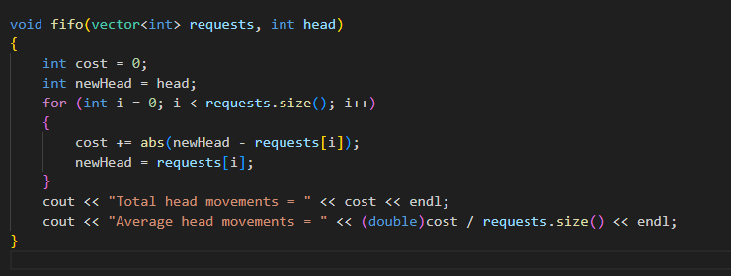
FIFO IMPLEMENTATION

Slide 9
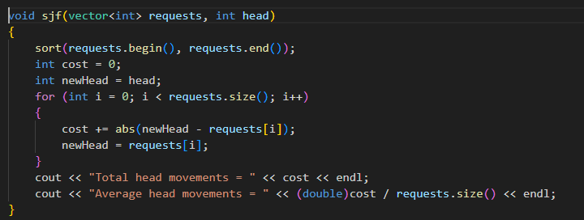
SJF IMPLEMENTATION

Slide 10
RR SCHEDULING
Round Robin (RR) simulates a cyclic approach to handle disk requests.
It processes each request one by one, looping over them.
Time quantum can be applied to limit each request's service time

Slide 11
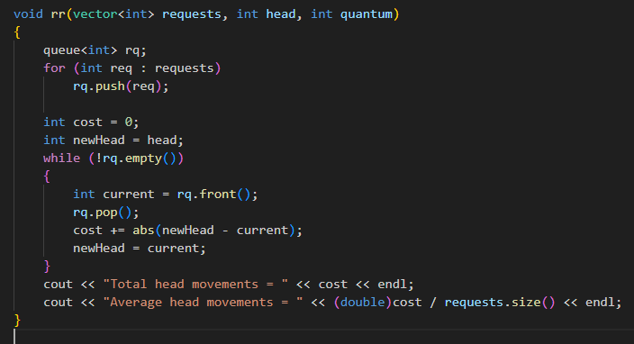
RR IMPLEMENTATION

Slide 12
CONCLUSION
We have implemented and analyzed three disk scheduling algorithms:
FIFO: Simple but can lead to high head movements.
SJF: Optimal in terms of head movements but requires knowledge of all requests.
RR: Fair, with cyclic processing, but may not minimize head movements.

Slide 13
THANK YOU

